Slide 1
甲殼類—蝦、蟹
一、海水蝦蟹類
劍蝦、厚殼蝦、大頭紅蝦(red shrimp)、
白鬚蝦、龍蝦(lobster)、帝王蟹(king crab)、
三點蟹、蠘仔、蟳螯蝦、蝦姑(mole cricket)、
旭蟹、鱟(horsefoot)等。
斑節蝦(kuruma shrimp)、草蝦(grass prawn)、
白蝦、沙蝦等。
二、淡水蝦蟹類

Slide 2
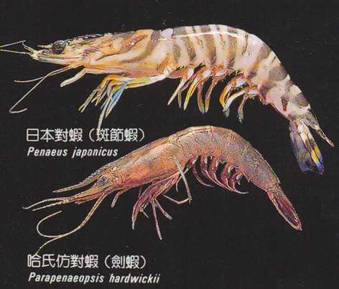
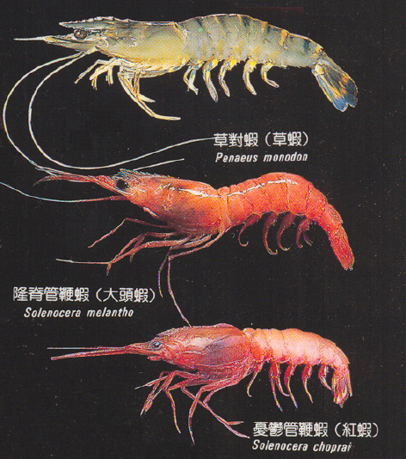
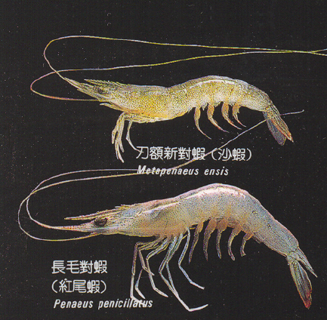
蝦類(shrimps-1)
Penaeus monodon

Slide 3
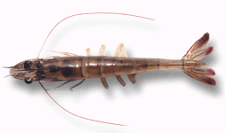
草蝦在台灣養殖已有多年歷史，早期採用與虱目魚混養方式，即利用雨季採捕河口天然生產的草蝦苗，放養於虱目魚塭中，成為副產物，57年人工育苗成功後逐漸有單養出現，並由於飼料開發及其他相關產業之發展，進展甚速，76年生產量曾達78548公噸，但好景不長，77年開始發生病變，79創低峰生產量只有8570公噸而已，近年來在大家的努力下以及土地再度恢復生機下，雖產量已有回升之勢，但是產業外移現象嚴重，地下水超抽以及人工成本增加等問題存在等現象 ，致使產量大不如前，目前市場上的草蝦大都是來自泰國、越南或大陸進口。

Slide 4
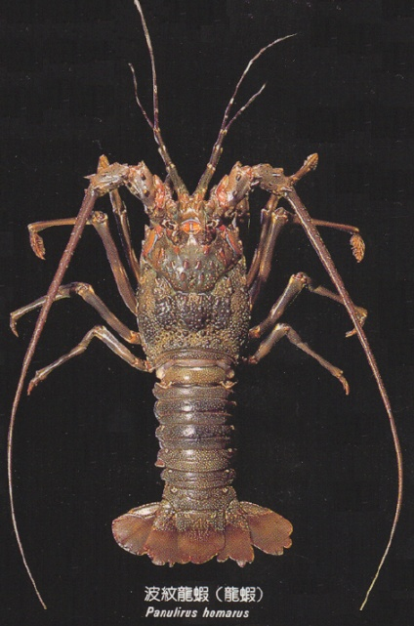
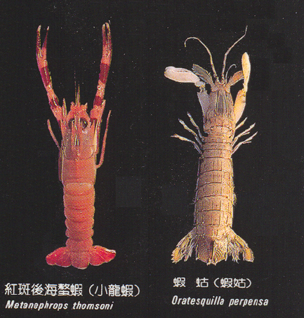
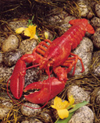
蝦類(shrimps-2)
Homarus americanus
Lobster is Canada’s most valuable seafood export, contributing as much as $1 billion in export sales. In many ways, lobster is Canada’s ambassador to the world and one of the exports most closely associated with this country. Consumers in 55 countries from Australia to Vietnam and all points around the globe enjoy lobster from Canada.

Slide 5
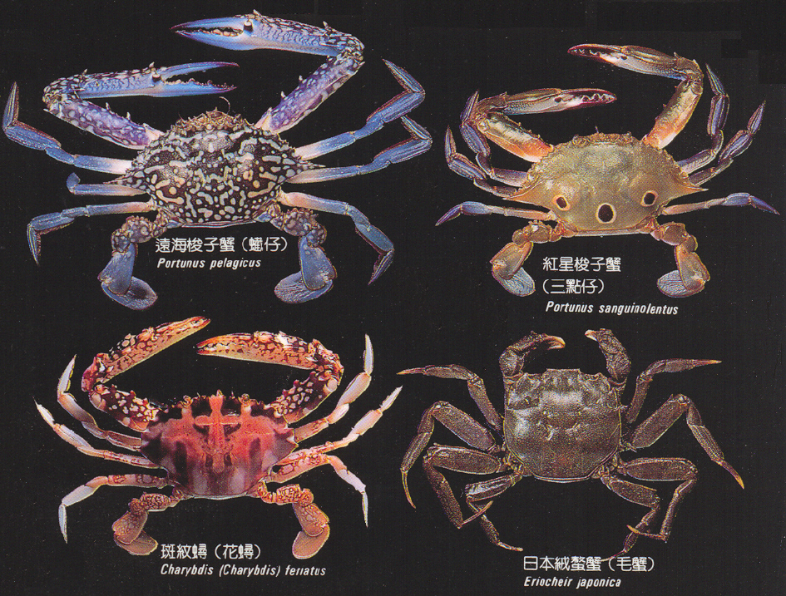
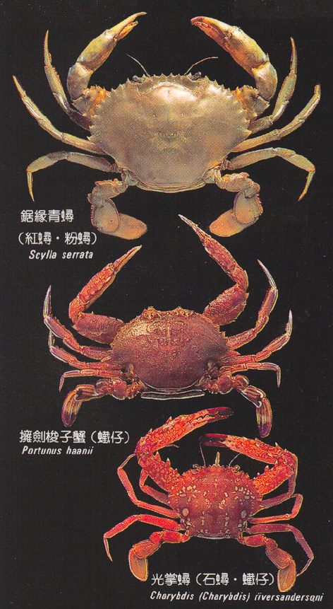
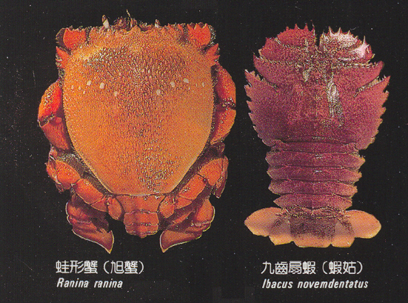
蟹類(crabs)

Slide 6
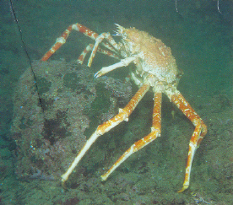
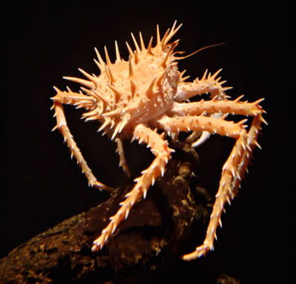
帝王蟹 King crab
Spiny king crab
King crab was also called Alaskan king crab, or Japanese crab (Paralithodes camtschatica), marine crustacean of the order Decapoda. This edible crab is found in the shallow waters off Japan and along the coast of Alaska. It also inhabits the Bering Sea. The king crab is one of the largest crabs, weighing 5 kg (11 lbs) or more. Its size and tasty flesh make it a valued food, and large numbers are commercially fished each year.

Slide 7
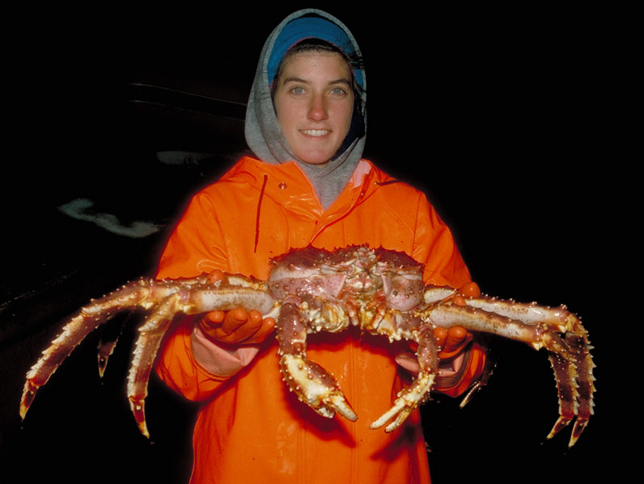
另種帝王蟹 Other king crab

Slide 8
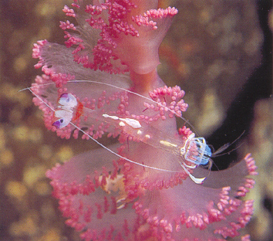
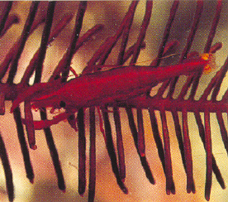
大岩蝦
共棲岩蝦
此等蝦類之體長均很小約2~3 cm 左右，有利用棲息物之隱藏效果，以逃避掠食者之捕食。

Slide 9
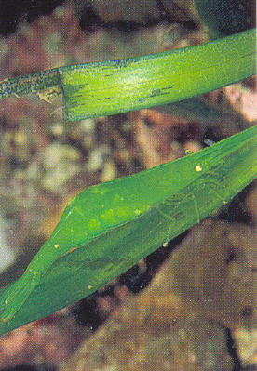
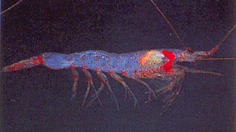
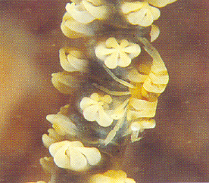
長額七腕蝦
櫻花蝦
隱蝦

